Slide 1
Coding Code of Conduct
Codes to code codes by

Slide 2
Overview
I already know all this
Why bother?
What?
Why is it important?
What are the risks?
What do we need then?
Final thoughts and Q&A

Slide 3
Aileen covered this already
(…very well and very thoroughly)
I already Git pulled the DE3 notes!

Slide 4
Why bother?

Slide 5
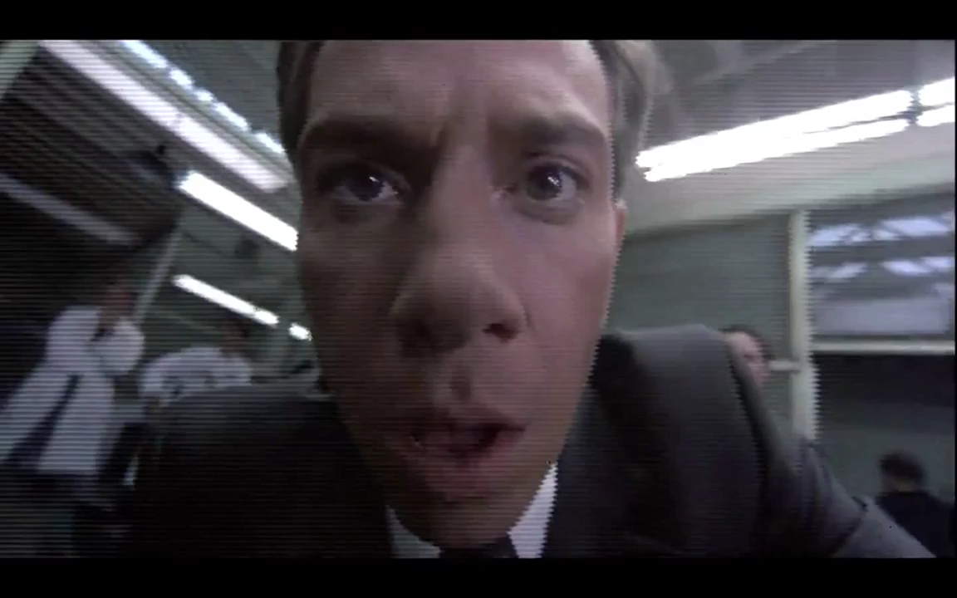
Humans versus robots

Slide 6
What is already in place?

Slide 7




Who do I pay attention to?

Slide 8
Who do I pay attention to?

Slide 9



Other Sectors

Slide 10

Dissecting the Hippocratic Oath

Slide 11
Dissecting the Hippocratic Oath
ὄμνυμι Ἀπόλλωνα ἰητρὸν καὶ Ἀσκληπιὸν καὶ Ὑγείαν καὶ Πανάκειαν καὶ θεοὺς πάντας τε καὶ πάσας, ἵστορας ποιεύμενος, ἐπιτελέα ποιήσειν κατὰ δύναμιν καὶ κρίσιν ἐμὴν ὅρκον τόνδε καὶ συγγραφὴν τήνδε:
ἡγήσεσθαι μὲν τὸν διδάξαντά με τὴν τέχνην ταύτην ἴσα γενέτῃσιν ἐμοῖς, καὶ βίου κοινώσεσθαι, καὶ χρεῶν χρηΐζοντι μετάδοσιν ποιήσεσθαι, καὶ γένος τὸ ἐξ αὐτοῦ ἀδελφοῖς ἴσον ἐπικρινεῖν ἄρρεσι, καὶ διδάξειν τὴν τέχνην ταύτην, ἢν χρηΐζωσι μανθάνειν, ἄνευ μισθοῦ καὶ συγγραφῆς, παραγγελίης τε καὶ ἀκροήσιος καὶ τῆς λοίπης ἁπάσης μαθήσιος μετάδοσιν ποιήσεσθαι υἱοῖς τε ἐμοῖς καὶ τοῖς τοῦ ἐμὲ διδάξαντος, καὶ μαθητῇσι συγγεγραμμένοις τε καὶ ὡρκισμένοις νόμῳ ἰητρικῷ, ἄλλῳ δὲ οὐδενί.
διαιτήμασί τε χρήσομαι ἐπ᾽ ὠφελείῃ καμνόντων κατὰ δύναμιν καὶ κρίσιν ἐμήν, ἐπὶ δηλήσει δὲ καὶ ἀδικίῃ εἴρξειν.
οὐ δώσω δὲ οὐδὲ φάρμακον οὐδενὶ αἰτηθεὶς θανάσιμον, οὐδὲ ὑφηγήσομαι συμβουλίην τοιήνδε: ὁμοίως δὲ οὐδὲ γυναικὶ πεσσὸν φθόριον δώσω.
ἁγνῶς δὲ καὶ ὁσίως διατηρήσω βίον τὸν ἐμὸν καὶ τέχνην τὴν ἐμήν.
οὐ τεμέω δὲ οὐδὲ μὴν λιθιῶντας, ἐκχωρήσω δὲ ἐργάτῃσιν ἀνδράσι πρήξιος τῆσδε.
ἐς οἰκίας δὲ ὁκόσας ἂν ἐσίω, ἐσελεύσομαι ἐπ᾽ ὠφελείῃ καμνόντων, ἐκτὸς ἐὼν πάσης ἀδικίης ἑκουσίης καὶ φθορίης, τῆς τε ἄλλης καὶ ἀφροδισίων ἔργων ἐπί τε γυναικείων σωμάτων καὶ ἀνδρῴων, ἐλευθέρων τε καὶ δούλων.
ἃ δ᾽ ἂν ἐνθεραπείῃ ἴδω ἢ ἀκούσω, ἢ καὶ ἄνευ θεραπείης κατὰ βίον ἀνθρώπων, ἃ μὴ χρή ποτε ἐκλαλεῖσθαι ἔξω, σιγήσομαι, ἄρρητα ἡγεύμενος εἶναι τὰ τοιαῦτα.
ὅρκον μὲν οὖν μοι τόνδε ἐπιτελέα ποιέοντι, καὶ μὴ συγχέοντι, εἴη ἐπαύρασθαι καὶ βίου καὶ τέχνης δοξαζομένῳ παρὰ πᾶσιν ἀνθρώποις ἐς τὸν αἰεὶ χρόνον: παραβαίνοντι δὲ καὶ ἐπιορκέοντι, τἀναντία τούτων.

Slide 12
Dissecting the Hippocratic Oath
I swear by Apollo Physician, by Asclepius, by Hygieia, by Panacea, and by all the gods and goddesses, making them my witnesses, that I will carry out, according to my ability and judgment, this oath and this indenture.
To hold my teacher in this art equal to my own parents; to make him partner in my livelihood; when he is in need of money to share mine with him; to consider his family as my own brothers, and to teach them this art, if they want to learn it, without fee or indenture; to impart precept, oral instruction, and all other instruction to my own sons, the sons of my teacher, and to indentured pupils who have taken the physician’s oath, but to nobody else.
I will use treatment to help the sick according to my ability and judgment, but never with a view to injury and wrong-doing. Neither will I administer a poison to anybody when asked to do so, nor will I suggest such a course. Similarly I will not give to a woman a pessary to cause abortion. But I will keep pure and holy both my life and my art. I will not use the knife, not even, verily, on sufferers from stone, but I will give place to such as are craftsmen therein.
Into whatsoever houses I enter, I will enter to help the sick, and I will abstain from all intentional wrong-doing and harm, especially from abusing the bodies of man or woman, bond or free. And whatsoever I shall see or hear in the course of my profession, as well as outside my profession in my intercourse with men, if it be what should not be published abroad, I will never divulge, holding such things to be holy secrets.
Now if I carry out this oath, and break it not, may I gain for ever reputation among all men for my life and for my art; but if I break it and forswear myself, may the opposite befall me.^{[6]} – Translation by W.H.S. Jones.
ὄμνυμι Ἀπόλλωνα ἰητρὸν καὶ Ἀσκληπιὸν καὶ Ὑγείαν καὶ Πανάκειαν καὶ θεοὺς πάντας τε καὶ πάσας, ἵστορας ποιεύμενος, ἐπιτελέα ποιήσειν κατὰ δύναμιν καὶ κρίσιν ἐμὴν ὅρκον τόνδε καὶ συγγραφὴν τήνδε:
ἡγήσεσθαι μὲν τὸν διδάξαντά με τὴν τέχνην ταύτην ἴσα γενέτῃσιν ἐμοῖς, καὶ βίου κοινώσεσθαι, καὶ χρεῶν χρηΐζοντι μετάδοσιν ποιήσεσθαι, καὶ γένος τὸ ἐξ αὐτοῦ ἀδελφοῖς ἴσον ἐπικρινεῖν ἄρρεσι, καὶ διδάξειν τὴν τέχνην ταύτην, ἢν χρηΐζωσι μανθάνειν, ἄνευ μισθοῦ καὶ συγγραφῆς, παραγγελίης τε καὶ ἀκροήσιος καὶ τῆς λοίπης ἁπάσης μαθήσιος μετάδοσιν ποιήσεσθαι υἱοῖς τε ἐμοῖς καὶ τοῖς τοῦ ἐμὲ διδάξαντος, καὶ μαθητῇσι συγγεγραμμένοις τε καὶ ὡρκισμένοις νόμῳ ἰητρικῷ, ἄλλῳ δὲ οὐδενί.
διαιτήμασί τε χρήσομαι ἐπ᾽ ὠφελείῃ καμνόντων κατὰ δύναμιν καὶ κρίσιν ἐμήν, ἐπὶ δηλήσει δὲ καὶ ἀδικίῃ εἴρξειν.
οὐ δώσω δὲ οὐδὲ φάρμακον οὐδενὶ αἰτηθεὶς θανάσιμον, οὐδὲ ὑφηγήσομαι συμβουλίην τοιήνδε: ὁμοίως δὲ οὐδὲ γυναικὶ πεσσὸν φθόριον δώσω.
ἁγνῶς δὲ καὶ ὁσίως διατηρήσω βίον τὸν ἐμὸν καὶ τέχνην τὴν ἐμήν.
οὐ τεμέω δὲ οὐδὲ μὴν λιθιῶντας, ἐκχωρήσω δὲ ἐργάτῃσιν ἀνδράσι πρήξιος τῆσδε.
ἐς οἰκίας δὲ ὁκόσας ἂν ἐσίω, ἐσελεύσομαι ἐπ᾽ ὠφελείῃ καμνόντων, ἐκτὸς ἐὼν πάσης ἀδικίης ἑκουσίης καὶ φθορίης, τῆς τε ἄλλης καὶ ἀφροδισίων ἔργων ἐπί τε γυναικείων σωμάτων καὶ ἀνδρῴων, ἐλευθέρων τε καὶ δούλων.
ἃ δ᾽ ἂν ἐνθεραπείῃ ἴδω ἢ ἀκούσω, ἢ καὶ ἄνευ θεραπείης κατὰ βίον ἀνθρώπων, ἃ μὴ χρή ποτε ἐκλαλεῖσθαι ἔξω, σιγήσομαι, ἄρρητα ἡγεύμενος εἶναι τὰ τοιαῦτα.
ὅρκον μὲν οὖν μοι τόνδε ἐπιτελέα ποιέοντι, καὶ μὴ συγχέοντι, εἴη ἐπαύρασθαι καὶ βίου καὶ τέχνης δοξαζομένῳ παρὰ πᾶσιν ἀνθρώποις ἐς τὸν αἰεὶ χρόνον: παραβαίνοντι δὲ καὶ ἐπιορκέοντι, τἀναντία τούτων.

Slide 13
Dissecting the Hippocratic Oath
I swear by Apollo Physician, by Asclepius, by Hygieia, by Panacea, and by all the gods and goddesses, making them my witnesses, that I will carry out, according to my ability and judgment, this oath and this indenture.
To hold my teacher in this art equal to my own parents; to make him partner in my livelihood; when he is in need of money to share mine with him; to consider his family as my own brothers, and to teach them this art, if they want to learn it, without fee or indenture; to impart precept, oral instruction, and all other instruction to my own sons, the sons of my teacher, and to indentured pupils who have taken the physician’s oath, but to nobody else.
I will use treatment to help the sick according to my ability and judgment, but never with a view to injury and wrong-doing. Neither will I administer a poison to anybody when asked to do so, nor will I suggest such a course. Similarly I will not give to a woman a pessary to cause abortion. But I will keep pure and holy both my life and my art. I will not use the knife, not even, verily, on sufferers from stone, but I will give place to such as are craftsmen therein.
Into whatsoever houses I enter, I will enter to help the sick, and I will abstain from all intentional wrong-doing and harm, especially from abusing the bodies of man or woman, bond or free. And whatsoever I shall see or hear in the course of my profession, as well as outside my profession in my intercourse with men, if it be what should not be published abroad, I will never divulge, holding such things to be holy secrets.
Now if I carry out this oath, and break it not, may I gain for ever reputation among all men for my life and for my art; but if I break it and forswear myself, may the opposite befall me.^{[6]} – Translation by W.H.S. Jones.
ὄμνυμι Ἀπόλλωνα ἰητρὸν καὶ Ἀσκληπιὸν καὶ Ὑγείαν καὶ Πανάκειαν καὶ θεοὺς πάντας τε καὶ πάσας, ἵστορας ποιεύμενος, ἐπιτελέα ποιήσειν κατὰ δύναμιν καὶ κρίσιν ἐμὴν ὅρκον τόνδε καὶ συγγραφὴν τήνδε:
ἡγήσεσθαι μὲν τὸν διδάξαντά με τὴν τέχνην ταύτην ἴσα γενέτῃσιν ἐμοῖς, καὶ βίου κοινώσεσθαι, καὶ χρεῶν χρηΐζοντι μετάδοσιν ποιήσεσθαι, καὶ γένος τὸ ἐξ αὐτοῦ ἀδελφοῖς ἴσον ἐπικρινεῖν ἄρρεσι, καὶ διδάξειν τὴν τέχνην ταύτην, ἢν χρηΐζωσι μανθάνειν, ἄνευ μισθοῦ καὶ συγγραφῆς, παραγγελίης τε καὶ ἀκροήσιος καὶ τῆς λοίπης ἁπάσης μαθήσιος μετάδοσιν ποιήσεσθαι υἱοῖς τε ἐμοῖς καὶ τοῖς τοῦ ἐμὲ διδάξαντος, καὶ μαθητῇσι συγγεγραμμένοις τε καὶ ὡρκισμένοις νόμῳ ἰητρικῷ, ἄλλῳ δὲ οὐδενί.
διαιτήμασί τε χρήσομαι ἐπ᾽ ὠφελείῃ καμνόντων κατὰ δύναμιν καὶ κρίσιν ἐμήν, ἐπὶ δηλήσει δὲ καὶ ἀδικίῃ εἴρξειν.
οὐ δώσω δὲ οὐδὲ φάρμακον οὐδενὶ αἰτηθεὶς θανάσιμον, οὐδὲ ὑφηγήσομαι συμβουλίην τοιήνδε: ὁμοίως δὲ οὐδὲ γυναικὶ πεσσὸν φθόριον δώσω.
ἁγνῶς δὲ καὶ ὁσίως διατηρήσω βίον τὸν ἐμὸν καὶ τέχνην τὴν ἐμήν.
οὐ τεμέω δὲ οὐδὲ μὴν λιθιῶντας, ἐκχωρήσω δὲ ἐργάτῃσιν ἀνδράσι πρήξιος τῆσδε.
ἐς οἰκίας δὲ ὁκόσας ἂν ἐσίω, ἐσελεύσομαι ἐπ᾽ ὠφελείῃ καμνόντων, ἐκτὸς ἐὼν πάσης ἀδικίης ἑκουσίης καὶ φθορίης, τῆς τε ἄλλης καὶ ἀφροδισίων ἔργων ἐπί τε γυναικείων σωμάτων καὶ ἀνδρῴων, ἐλευθέρων τε καὶ δούλων.
ἃ δ᾽ ἂν ἐνθεραπείῃ ἴδω ἢ ἀκούσω, ἢ καὶ ἄνευ θεραπείης κατὰ βίον ἀνθρώπων, ἃ μὴ χρή ποτε ἐκλαλεῖσθαι ἔξω, σιγήσομαι, ἄρρητα ἡγεύμενος εἶναι τὰ τοιαῦτα.
ὅρκον μὲν οὖν μοι τόνδε ἐπιτελέα ποιέοντι, καὶ μὴ συγχέοντι, εἴη ἐπαύρασθαι καὶ βίου καὶ τέχνης δοξαζομένῳ παρὰ πᾶσιν ἀνθρώποις ἐς τὸν αἰεὶ χρόνον: παραβαίνοντι δὲ καὶ ἐπιορκέοντι, τἀναντία τούτων.
I swear to fulfill, to the best of my ability and judgment, this covenant:
I will respect the hard-won scientific gains of those physicians in whose steps I walk, and gladly share such knowledge as is mine with those who are to follow.
I will apply, for the benefit of the sick, all measures [that] are required, avoiding those twin traps of overtreatment and therapeutic nihilism.
I will remember that there is art to medicine as well as science, and that warmth, sympathy, and understanding may outweigh the surgeon's knife or the chemist's drug.
I will not be ashamed to say "I know not," nor will I fail to call in my colleagues when the skills of another are needed for a patient's recovery.
I will respect the privacy of my patients, for their problems are not disclosed to me that the world may know. Most especially must I tread with care in matters of life and death. If it is given me to save a life, all thanks. But it may also be within my power to take a life; this awesome responsibility must be faced with great humbleness and awareness of my own frailty. Above all, I must not play at God.
I will remember that I do not treat a fever chart, a cancerous growth, but a sick human being, whose illness may affect the person's family and economic stability. My responsibility includes these related problems, if I am to care adequately for the sick.
I will prevent disease whenever I can, for prevention is preferable to cure.
I will protect the environment which sustains us, in the knowledge that the continuing health of ourselves and our societies is dependent on a healthy planet.
I will remember that I remain a member of society, with special obligations to all my fellow human beings, those sound of mind and body as well as the infirm.
If I do not violate this oath, may I enjoy life and art, respected while I live and remembered with affection thereafter. May I always act so as to preserve the finest traditions of my calling and may I long experience the joy of healing those who seek my help.

Slide 14
Dissecting the Hippocratic Oath
ὄμνυμι Ἀπόλλωνα ἰητρὸν καὶ Ἀσκληπιὸν καὶ Ὑγείαν καὶ Πανάκειαν καὶ θεοὺς πάντας τε καὶ πάσας, ἵστορας ποιεύμενος, ἐπιτελέα ποιήσειν κατὰ δύναμιν καὶ κρίσιν ἐμὴν ὅρκον τόνδε καὶ συγγραφὴν τήνδε:
ἡγήσεσθαι μὲν τὸν διδάξαντά με τὴν τέχνην ταύτην ἴσα γενέτῃσιν ἐμοῖς, καὶ βίου κοινώσεσθαι, καὶ χρεῶν χρηΐζοντι μετάδοσιν ποιήσεσθαι, καὶ γένος τὸ ἐξ αὐτοῦ ἀδελφοῖς ἴσον ἐπικρινεῖν ἄρρεσι, καὶ διδάξειν τὴν τέχνην ταύτην, ἢν χρηΐζωσι μανθάνειν, ἄνευ μισθοῦ καὶ συγγραφῆς, παραγγελίης τε καὶ ἀκροήσιος καὶ τῆς λοίπης ἁπάσης μαθήσιος μετάδοσιν ποιήσεσθαι υἱοῖς τε ἐμοῖς καὶ τοῖς τοῦ ἐμὲ διδάξαντος, καὶ μαθητῇσι συγγεγραμμένοις τε καὶ ὡρκισμένοις νόμῳ ἰητρικῷ, ἄλλῳ δὲ οὐδενί.
διαιτήμασί τε χρήσομαι ἐπ᾽ ὠφελείῃ καμνόντων κατὰ δύναμιν καὶ κρίσιν ἐμήν, ἐπὶ δηλήσει δὲ καὶ ἀδικίῃ εἴρξειν.
οὐ δώσω δὲ οὐδὲ φάρμακον οὐδενὶ αἰτηθεὶς θανάσιμον, οὐδὲ ὑφηγήσομαι συμβουλίην τοιήνδε: ὁμοίως δὲ οὐδὲ γυναικὶ πεσσὸν φθόριον δώσω.
ἁγνῶς δὲ καὶ ὁσίως διατηρήσω βίον τὸν ἐμὸν καὶ τέχνην τὴν ἐμήν.
οὐ τεμέω δὲ οὐδὲ μὴν λιθιῶντας, ἐκχωρήσω δὲ ἐργάτῃσιν ἀνδράσι πρήξιος τῆσδε.
ἐς οἰκίας δὲ ὁκόσας ἂν ἐσίω, ἐσελεύσομαι ἐπ᾽ ὠφελείῃ καμνόντων, ἐκτὸς ἐὼν πάσης ἀδικίης ἑκουσίης καὶ φθορίης, τῆς τε ἄλλης καὶ ἀφροδισίων ἔργων ἐπί τε γυναικείων σωμάτων καὶ ἀνδρῴων, ἐλευθέρων τε καὶ δούλων.
ἃ δ᾽ ἂν ἐνθεραπείῃ ἴδω ἢ ἀκούσω, ἢ καὶ ἄνευ θεραπείης κατὰ βίον ἀνθρώπων, ἃ μὴ χρή ποτε ἐκλαλεῖσθαι ἔξω, σιγήσομαι, ἄρρητα ἡγεύμενος εἶναι τὰ τοιαῦτα.
ὅρκον μὲν οὖν μοι τόνδε ἐπιτελέα ποιέοντι, καὶ μὴ συγχέοντι, εἴη ἐπαύρασθαι καὶ βίου καὶ τέχνης δοξαζομένῳ παρὰ πᾶσιν ἀνθρώποις ἐς τὸν αἰεὶ χρόνον: παραβαίνοντι δὲ καὶ ἐπιορκέοντι, τἀναντία τούτων.
best of my ability and judgment
share such knowledge
all measures [that] are required
warmth, sympathy, and understanding
not be ashamed to say "I know not,"
respect the privacy of my patients
responsibility must be faced with great humbleness and awareness of my own frailty. Above all, I must not play at God.
human being, whose illness may affect the person's family and economic stability.
prevention is preferable to cure.
health of ourselves and our societies is dependent on a healthy planet.
special obligations to all my fellow human beings
preserve the finest traditions of my calling
I swear to fulfill, to the best of my ability and judgment, this covenant:
I will respect the hard-won scientific gains of those physicians in whose steps I walk, and gladly share such knowledge as is mine with those who are to follow.
I will apply, for the benefit of the sick, all measures [that] are required, avoiding those twin traps of overtreatment and therapeutic nihilism.
I will remember that there is art to medicine as well as science, and that warmth, sympathy, and understanding may outweigh the surgeon's knife or the chemist's drug.
I will not be ashamed to say "I know not," nor will I fail to call in my colleagues when the skills of another are needed for a patient's recovery.
I will respect the privacy of my patients, for their problems are not disclosed to me that the world may know. Most especially must I tread with care in matters of life and death. If it is given me to save a life, all thanks. But it may also be within my power to take a life; this awesome responsibility must be faced with great humbleness and awareness of my own frailty. Above all, I must not play at God.
I will remember that I do not treat a fever chart, a cancerous growth, but a sick human being, whose illness may affect the person's family and economic stability. My responsibility includes these related problems, if I am to care adequately for the sick.
I will prevent disease whenever I can, for prevention is preferable to cure.
I will protect the environment which sustains us, in the knowledge that the continuing health of ourselves and our societies is dependent on a healthy planet.
I will remember that I remain a member of society, with special obligations to all my fellow human beings, those sound of mind and body as well as the infirm.
If I do not violate this oath, may I enjoy life and art, respected while I live and remembered with affection thereafter. May I always act so as to preserve the finest traditions of my calling and may I long experience the joy of healing those who seek my help.

Slide 15
Dissecting the Hippocratic Oath
I swear by Apollo Physician, by Asclepius, by Hygieia, by Panacea, and by all the gods and goddesses, making them my witnesses, that I will carry out, according to my ability and judgment, this oath and this indenture.
To hold my teacher in this art equal to my own parents; to make him partner in my livelihood; when he is in need of money to share mine with him; to consider his family as my own brothers, and to teach them this art, if they want to learn it, without fee or indenture; to impart precept, oral instruction, and all other instruction to my own sons, the sons of my teacher, and to indentured pupils who have taken the physician’s oath, but to nobody else.
I will use treatment to help the sick according to my ability and judgment, but never with a view to injury and wrong-doing. Neither will I administer a poison to anybody when asked to do so, nor will I suggest such a course. Similarly I will not give to a woman a pessary to cause abortion. But I will keep pure and holy both my life and my art. I will not use the knife, not even, verily, on sufferers from stone, but I will give place to such as are craftsmen therein.
Into whatsoever houses I enter, I will enter to help the sick, and I will abstain from all intentional wrong-doing and harm, especially from abusing the bodies of man or woman, bond or free. And whatsoever I shall see or hear in the course of my profession, as well as outside my profession in my intercourse with men, if it be what should not be published abroad, I will never divulge, holding such things to be holy secrets.
Now if I carry out this oath, and break it not, may I gain for ever reputation among all men for my life and for my art; but if I break it and forswear myself, may the opposite befall me.^{[6]} – Translation by W.H.S. Jones.
ὄμνυμι Ἀπόλλωνα ἰητρὸν καὶ Ἀσκληπιὸν καὶ Ὑγείαν καὶ Πανάκειαν καὶ θεοὺς πάντας τε καὶ πάσας, ἵστορας ποιεύμενος, ἐπιτελέα ποιήσειν κατὰ δύναμιν καὶ κρίσιν ἐμὴν ὅρκον τόνδε καὶ συγγραφὴν τήνδε:
ἡγήσεσθαι μὲν τὸν διδάξαντά με τὴν τέχνην ταύτην ἴσα γενέτῃσιν ἐμοῖς, καὶ βίου κοινώσεσθαι, καὶ χρεῶν χρηΐζοντι μετάδοσιν ποιήσεσθαι, καὶ γένος τὸ ἐξ αὐτοῦ ἀδελφοῖς ἴσον ἐπικρινεῖν ἄρρεσι, καὶ διδάξειν τὴν τέχνην ταύτην, ἢν χρηΐζωσι μανθάνειν, ἄνευ μισθοῦ καὶ συγγραφῆς, παραγγελίης τε καὶ ἀκροήσιος καὶ τῆς λοίπης ἁπάσης μαθήσιος μετάδοσιν ποιήσεσθαι υἱοῖς τε ἐμοῖς καὶ τοῖς τοῦ ἐμὲ διδάξαντος, καὶ μαθητῇσι συγγεγραμμένοις τε καὶ ὡρκισμένοις νόμῳ ἰητρικῷ, ἄλλῳ δὲ οὐδενί.
διαιτήμασί τε χρήσομαι ἐπ᾽ ὠφελείῃ καμνόντων κατὰ δύναμιν καὶ κρίσιν ἐμήν, ἐπὶ δηλήσει δὲ καὶ ἀδικίῃ εἴρξειν.
οὐ δώσω δὲ οὐδὲ φάρμακον οὐδενὶ αἰτηθεὶς θανάσιμον, οὐδὲ ὑφηγήσομαι συμβουλίην τοιήνδε: ὁμοίως δὲ οὐδὲ γυναικὶ πεσσὸν φθόριον δώσω.
ἁγνῶς δὲ καὶ ὁσίως διατηρήσω βίον τὸν ἐμὸν καὶ τέχνην τὴν ἐμήν.
οὐ τεμέω δὲ οὐδὲ μὴν λιθιῶντας, ἐκχωρήσω δὲ ἐργάτῃσιν ἀνδράσι πρήξιος τῆσδε.
ἐς οἰκίας δὲ ὁκόσας ἂν ἐσίω, ἐσελεύσομαι ἐπ᾽ ὠφελείῃ καμνόντων, ἐκτὸς ἐὼν πάσης ἀδικίης ἑκουσίης καὶ φθορίης, τῆς τε ἄλλης καὶ ἀφροδισίων ἔργων ἐπί τε γυναικείων σωμάτων καὶ ἀνδρῴων, ἐλευθέρων τε καὶ δούλων.
ἃ δ᾽ ἂν ἐνθεραπείῃ ἴδω ἢ ἀκούσω, ἢ καὶ ἄνευ θεραπείης κατὰ βίον ἀνθρώπων, ἃ μὴ χρή ποτε ἐκλαλεῖσθαι ἔξω, σιγήσομαι, ἄρρητα ἡγεύμενος εἶναι τὰ τοιαῦτα.
ὅρκον μὲν οὖν μοι τόνδε ἐπιτελέα ποιέοντι, καὶ μὴ συγχέοντι, εἴη ἐπαύρασθαι καὶ βίου καὶ τέχνης δοξαζομένῳ παρὰ πᾶσιν ἀνθρώποις ἐς τὸν αἰεὶ χρόνον: παραβαίνοντι δὲ καὶ ἐπιορκέοντι, τἀναντία τούτων.
best of my ability and judgment
share such knowledge
all measures [that] are required
warmth, sympathy, and understanding
not be ashamed to say "I know not,"
respect the privacy of my patients
responsibility must be faced with great humbleness and awareness of my own frailty. Above all, I must not play at God.
human being, whose illness may affect the person's family and economic stability.
prevention is preferable to cure.
health of ourselves and our societies is dependent on a healthy planet.
special obligations to all my fellow human beings
preserve the finest traditions of my calling
I swear to fulfill, to the best of my ability and judgment, this covenant:
I will respect the hard-won scientific gains of those physicians in whose steps I walk, and gladly share such knowledge as is mine with those who are to follow.
I will apply, for the benefit of the sick, all measures [that] are required, avoiding those twin traps of overtreatment and therapeutic nihilism.
I will remember that there is art to medicine as well as science, and that warmth, sympathy, and understanding may outweigh the surgeon's knife or the chemist's drug.
I will not be ashamed to say "I know not," nor will I fail to call in my colleagues when the skills of another are needed for a patient's recovery.
I will respect the privacy of my patients, for their problems are not disclosed to me that the world may know. Most especially must I tread with care in matters of life and death. If it is given me to save a life, all thanks. But it may also be within my power to take a life; this awesome responsibility must be faced with great humbleness and awareness of my own frailty. Above all, I must not play at God.
I will remember that I do not treat a fever chart, a cancerous growth, but a sick human being, whose illness may affect the person's family and economic stability. My responsibility includes these related problems, if I am to care adequately for the sick.
I will prevent disease whenever I can, for prevention is preferable to cure.
I will protect the environment which sustains us, in the knowledge that the continuing health of ourselves and our societies is dependent on a healthy planet.
I will remember that I remain a member of society, with special obligations to all my fellow human beings, those sound of mind and body as well as the infirm.
If I do not violate this oath, may I enjoy life and art, respected while I live and remembered with affection thereafter. May I always act so as to preserve the finest traditions of my calling and may I long experience the joy of healing those who seek my help.

Slide 16
Dissecting the Hippocratic Oath
I swear by Apollo Physician, by Asclepius, by Hygieia, by Panacea, and by all the gods and goddesses, making them my witnesses, that I will carry out, according to my ability and judgment, this oath and this indenture.
To hold my teacher in this art equal to my own parents; to make him partner in my livelihood; when he is in need of money to share mine with him; to consider his family as my own brothers, and to teach them this art, if they want to learn it, without fee or indenture; to impart precept, oral instruction, and all other instruction to my own sons, the sons of my teacher, and to indentured pupils who have taken the physician’s oath, but to nobody else.
I will use treatment to help the sick according to my ability and judgment, but never with a view to injury and wrong-doing. Neither will I administer a poison to anybody when asked to do so, nor will I suggest such a course. Similarly I will not give to a woman a pessary to cause abortion. But I will keep pure and holy both my life and my art. I will not use the knife, not even, verily, on sufferers from stone, but I will give place to such as are craftsmen therein.
Into whatsoever houses I enter, I will enter to help the sick, and I will abstain from all intentional wrong-doing and harm, especially from abusing the bodies of man or woman, bond or free. And whatsoever I shall see or hear in the course of my profession, as well as outside my profession in my intercourse with men, if it be what should not be published abroad, I will never divulge, holding such things to be holy secrets.
Now if I carry out this oath, and break it not, may I gain for ever reputation among all men for my life and for my art; but if I break it and forswear myself, may the opposite befall me.^{[6]} – Translation by W.H.S. Jones.
ὄμνυμι Ἀπόλλωνα ἰητρὸν καὶ Ἀσκληπιὸν καὶ Ὑγείαν καὶ Πανάκειαν καὶ θεοὺς πάντας τε καὶ πάσας, ἵστορας ποιεύμενος, ἐπιτελέα ποιήσειν κατὰ δύναμιν καὶ κρίσιν ἐμὴν ὅρκον τόνδε καὶ συγγραφὴν τήνδε:
ἡγήσεσθαι μὲν τὸν διδάξαντά με τὴν τέχνην ταύτην ἴσα γενέτῃσιν ἐμοῖς, καὶ βίου κοινώσεσθαι, καὶ χρεῶν χρηΐζοντι μετάδοσιν ποιήσεσθαι, καὶ γένος τὸ ἐξ αὐτοῦ ἀδελφοῖς ἴσον ἐπικρινεῖν ἄρρεσι, καὶ διδάξειν τὴν τέχνην ταύτην, ἢν χρηΐζωσι μανθάνειν, ἄνευ μισθοῦ καὶ συγγραφῆς, παραγγελίης τε καὶ ἀκροήσιος καὶ τῆς λοίπης ἁπάσης μαθήσιος μετάδοσιν ποιήσεσθαι υἱοῖς τε ἐμοῖς καὶ τοῖς τοῦ ἐμὲ διδάξαντος, καὶ μαθητῇσι συγγεγραμμένοις τε καὶ ὡρκισμένοις νόμῳ ἰητρικῷ, ἄλλῳ δὲ οὐδενί.
διαιτήμασί τε χρήσομαι ἐπ᾽ ὠφελείῃ καμνόντων κατὰ δύναμιν καὶ κρίσιν ἐμήν, ἐπὶ δηλήσει δὲ καὶ ἀδικίῃ εἴρξειν.
οὐ δώσω δὲ οὐδὲ φάρμακον οὐδενὶ αἰτηθεὶς θανάσιμον, οὐδὲ ὑφηγήσομαι συμβουλίην τοιήνδε: ὁμοίως δὲ οὐδὲ γυναικὶ πεσσὸν φθόριον δώσω.
ἁγνῶς δὲ καὶ ὁσίως διατηρήσω βίον τὸν ἐμὸν καὶ τέχνην τὴν ἐμήν.
οὐ τεμέω δὲ οὐδὲ μὴν λιθιῶντας, ἐκχωρήσω δὲ ἐργάτῃσιν ἀνδράσι πρήξιος τῆσδε.
ἐς οἰκίας δὲ ὁκόσας ἂν ἐσίω, ἐσελεύσομαι ἐπ᾽ ὠφελείῃ καμνόντων, ἐκτὸς ἐὼν πάσης ἀδικίης ἑκουσίης καὶ φθορίης, τῆς τε ἄλλης καὶ ἀφροδισίων ἔργων ἐπί τε γυναικείων σωμάτων καὶ ἀνδρῴων, ἐλευθέρων τε καὶ δούλων.
ἃ δ᾽ ἂν ἐνθεραπείῃ ἴδω ἢ ἀκούσω, ἢ καὶ ἄνευ θεραπείης κατὰ βίον ἀνθρώπων, ἃ μὴ χρή ποτε ἐκλαλεῖσθαι ἔξω, σιγήσομαι, ἄρρητα ἡγεύμενος εἶναι τὰ τοιαῦτα.
ὅρκον μὲν οὖν μοι τόνδε ἐπιτελέα ποιέοντι, καὶ μὴ συγχέοντι, εἴη ἐπαύρασθαι καὶ βίου καὶ τέχνης δοξαζομένῳ παρὰ πᾶσιν ἀνθρώποις ἐς τὸν αἰεὶ χρόνον: παραβαίνοντι δὲ καὶ ἐπιορκέοντι, τἀναντία τούτων.
best of my ability and judgment
share such knowledge
all measures [that] are required
warmth, sympathy, and understanding
not be ashamed to say "I know not,"
respect the privacy of my patients
responsibility must be faced with great humbleness and awareness of my own frailty. Above all, I must not play at God.
human being, whose illness may affect the person's family and economic stability.
prevention is preferable to cure.
health of ourselves and our societies is dependent on a healthy planet.
special obligations to all my fellow human beings
preserve the finest traditions of my calling
best of my ability and judgment
share such knowledge
all measures [that] are required
warmth, sympathy, and understanding
not be ashamed to say "I know not,"
respect the privacy of my patients
responsibility must be faced with great humbleness and awareness of my own frailty. Above all, I must not play at God.
human being, whose illness may affect the person's family and economic stability.
prevention is preferable to cure.
health of ourselves and our societies is dependent on a healthy planet.
special obligations to all my fellow human beings
preserve the finest traditions of my calling
I swear to fulfill, to the best of my ability and judgment, this covenant:
I will respect the hard-won scientific gains of those physicians in whose steps I walk, and gladly share such knowledge as is mine with those who are to follow.
I will apply, for the benefit of the sick, all measures [that] are required, avoiding those twin traps of overtreatment and therapeutic nihilism.
I will remember that there is art to medicine as well as science, and that warmth, sympathy, and understanding may outweigh the surgeon's knife or the chemist's drug.
I will not be ashamed to say "I know not," nor will I fail to call in my colleagues when the skills of another are needed for a patient's recovery.
I will respect the privacy of my patients, for their problems are not disclosed to me that the world may know. Most especially must I tread with care in matters of life and death. If it is given me to save a life, all thanks. But it may also be within my power to take a life; this awesome responsibility must be faced with great humbleness and awareness of my own frailty. Above all, I must not play at God.
I will remember that I do not treat a fever chart, a cancerous growth, but a sick human being, whose illness may affect the person's family and economic stability. My responsibility includes these related problems, if I am to care adequately for the sick.
I will prevent disease whenever I can, for prevention is preferable to cure.
I will protect the environment which sustains us, in the knowledge that the continuing health of ourselves and our societies is dependent on a healthy planet.
I will remember that I remain a member of society, with special obligations to all my fellow human beings, those sound of mind and body as well as the infirm.
If I do not violate this oath, may I enjoy life and art, respected while I live and remembered with affection thereafter. May I always act so as to preserve the finest traditions of my calling and may I long experience the joy of healing those who seek my help.

Slide 17
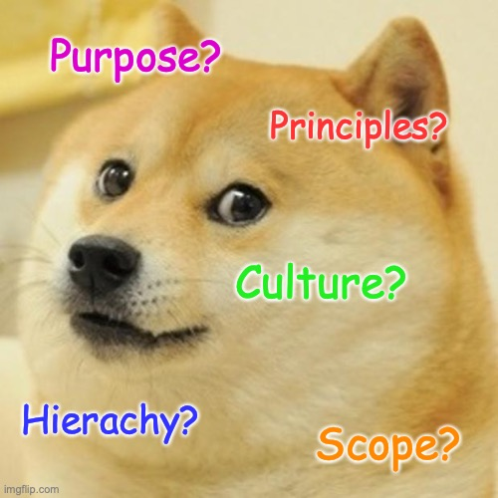
Key Variables for Consideration

Slide 18
Why is it important?

Slide 19
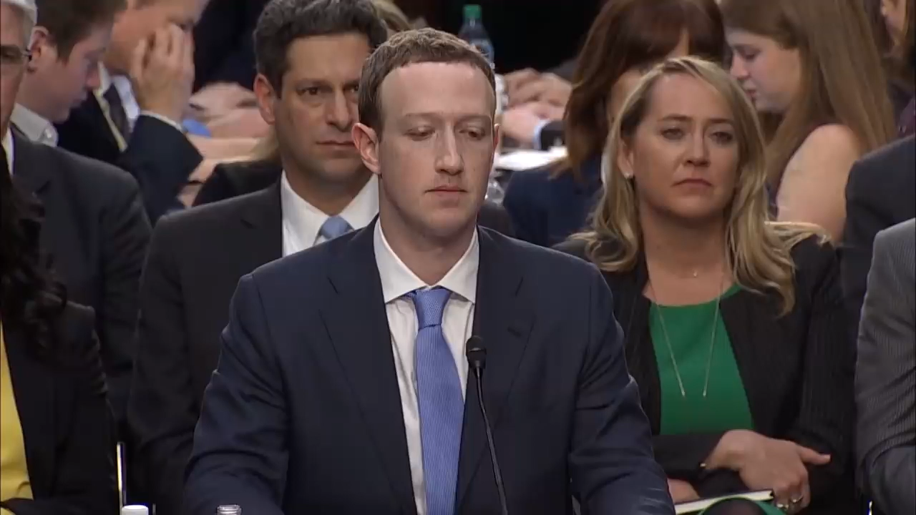
Political will / ability / competence

Slide 21
What are the risks?

Slide 23
Current
Issues
Spread of information and fake news
Data collection, storage and minimisation
Privacy, consent and linking data
Use of automation in government/civil service
Scale of automation
Use of public data
Explainability and understanding of models
Bias

Slide 24
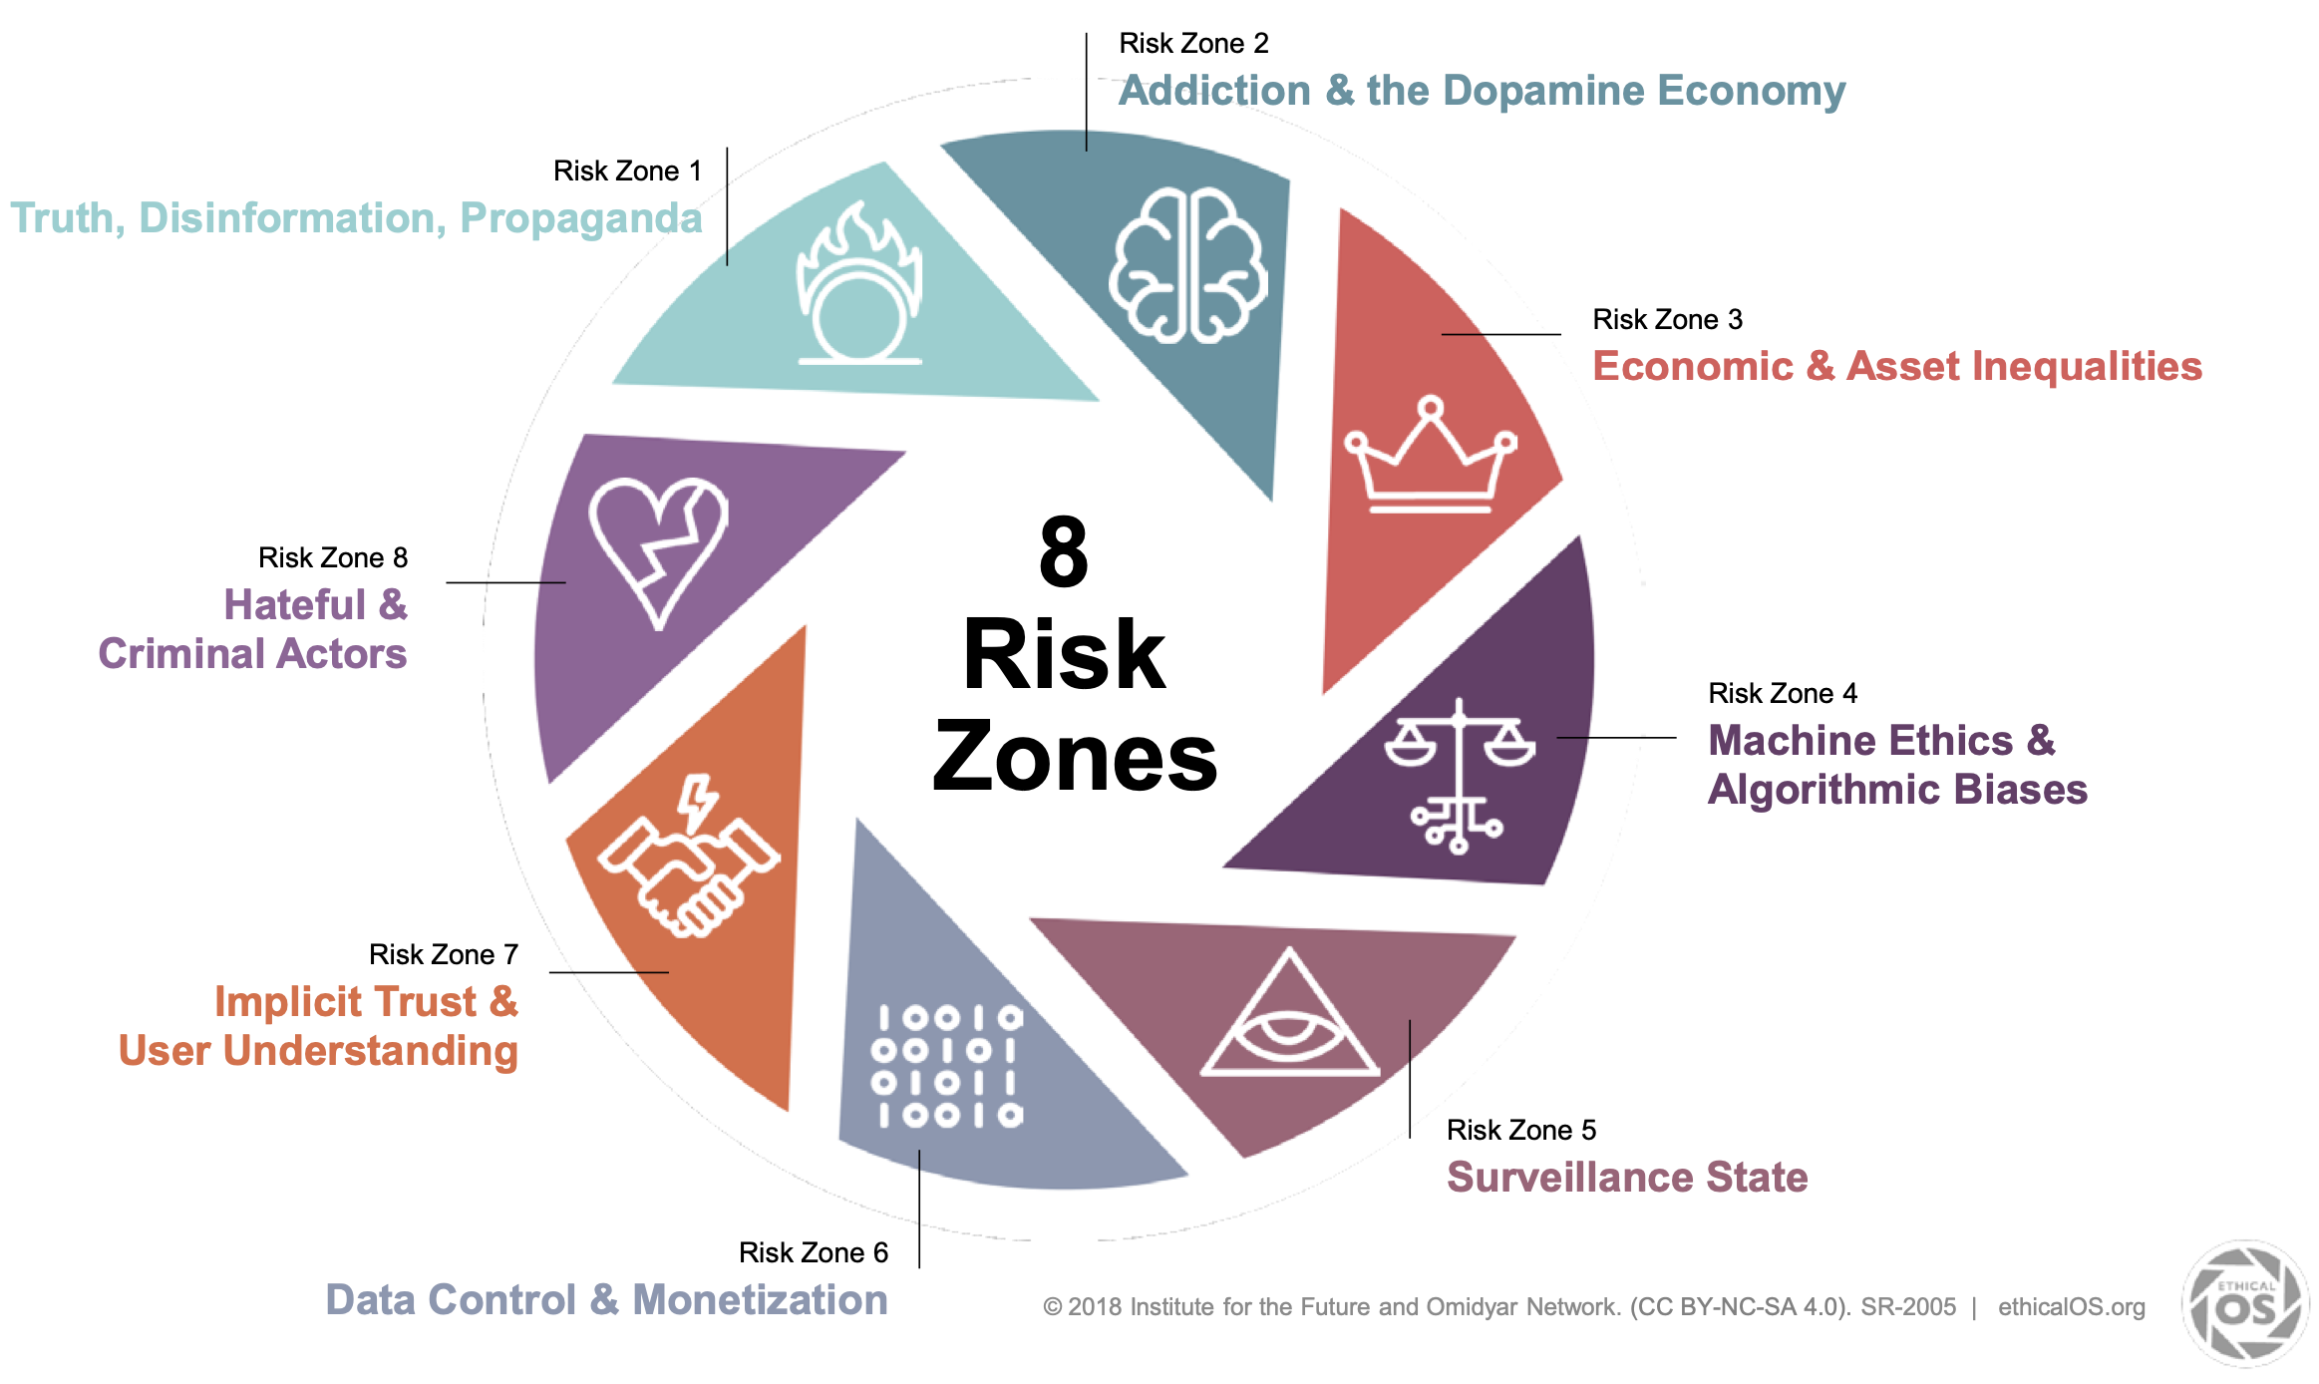

Slide 25
What do we need then?

Slide 26
Code of Conduct Distillation: Values
Values
Public
Knowledge
Skill and due diligence
Hierarchy
Integrity
Transparency

Slide 27
Code of Conduct Distillation: Stakeholders
Data Economy
Company
Individual
Industry
Public

Slide 28
Final thoughts
(and questions)

Slide 29
Deterrent
Understanding
Communication
Collaboration
Public
Public
Data people
Share Holders
Penalties
Developers
Bad Actors
Management
Industry
Individuals
Regulation
Government
Culture
Integrity
Progress
Responsibility
Collaboration
Transparency

Slide 30

DataKind Code
I will actively seek to consider harms and benefits of my work with DataKind UK.
I will actively seek to understand the context of the data and tools I use.
I will enable others to understand the data and analysis choices I have made, now and in the future.
I will actively seek to understand my own limits and the limits of the organisations involved.
I will debate and discuss ethical choices

